Slide 1

Chapter 9 – part I

Slide 2
OUTLINE
  Angular velocity and acceleration.
  Rotation with constant angular acceleration.
  Problems.

Slide 3
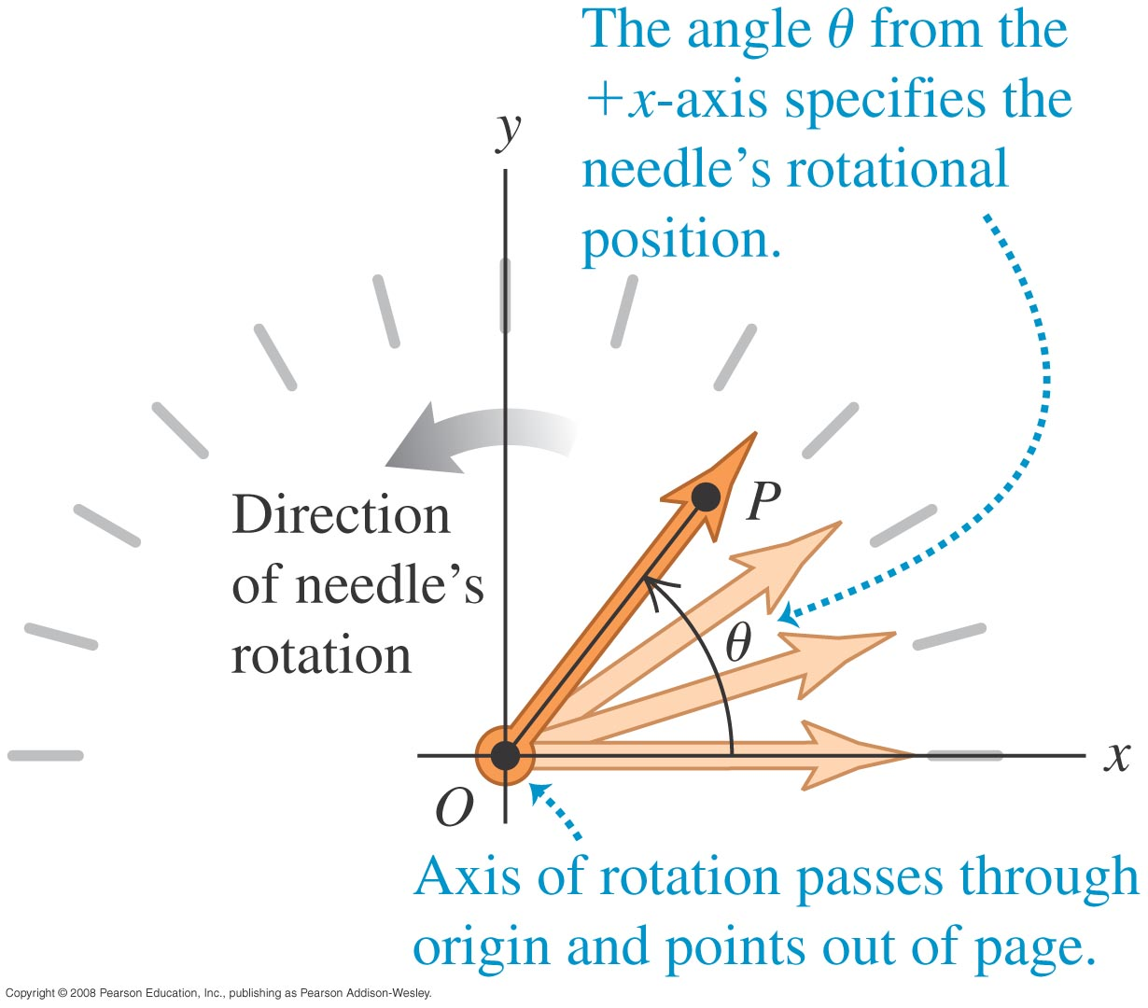
Angular coordinate
A car’s speedometer needle rotates about a fixed axis, as shown at the right.
The angle θ that the needle makes with the +x-axis is a coordinate for rotation.

Slide 4
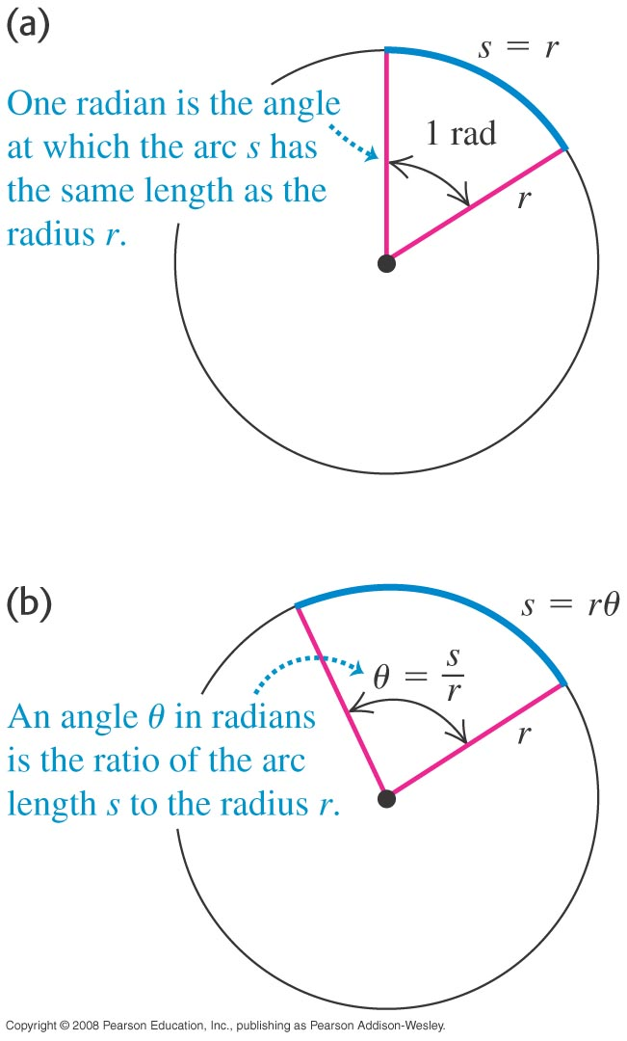
Units of angles
An angle in radians is
θ = s/r, as shown in the figure.
One complete revolution is 360° = 2π radians.

Slide 5
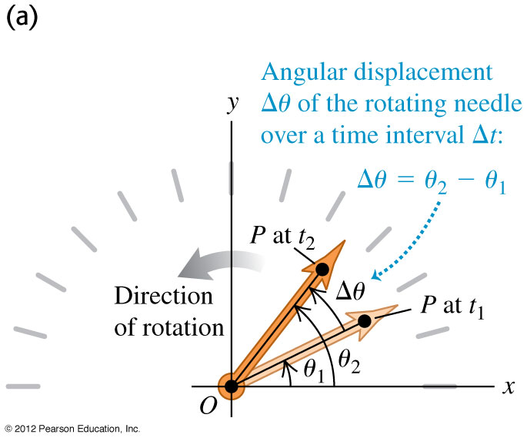
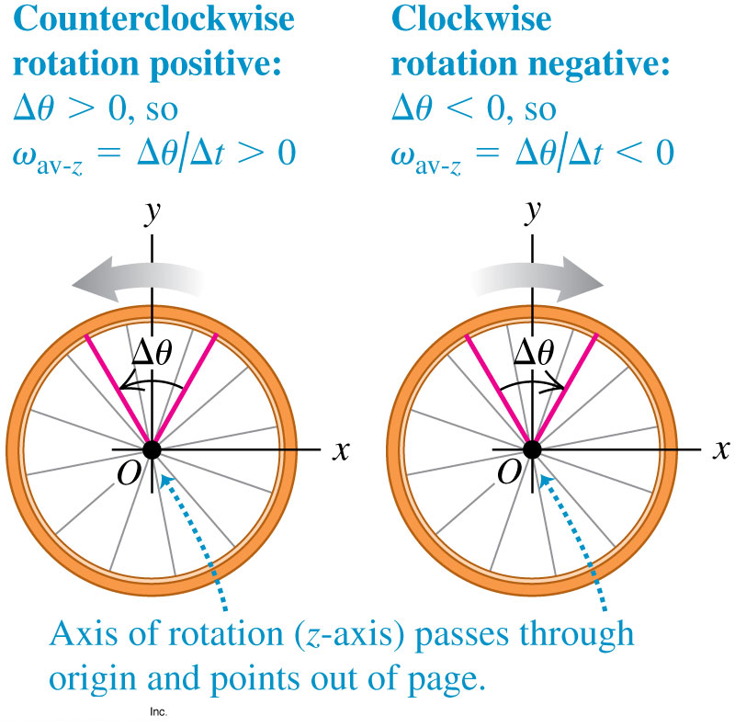
Angular velocity
The angular displacement Δθ of a body is Δθ = θ₂ – θ₁.
The average angular velocity of a body is ω_{av-z} = Δθ/Δt.
The subscript z means that the rotation is about the z-axis.
The instantaneous angular velocity is ω_{z} = dθ/dt.
A counterclockwise rotation is positive; a clockwise rotation is negative.

Slide 6
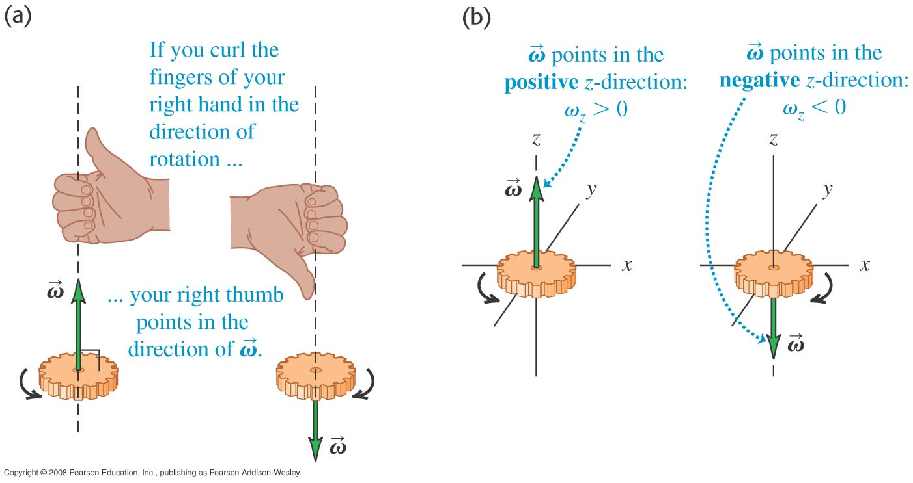
Angular velocity is a vector
Angular velocity is defined as a vector whose direction is given by the right-hand rule.

Slide 7
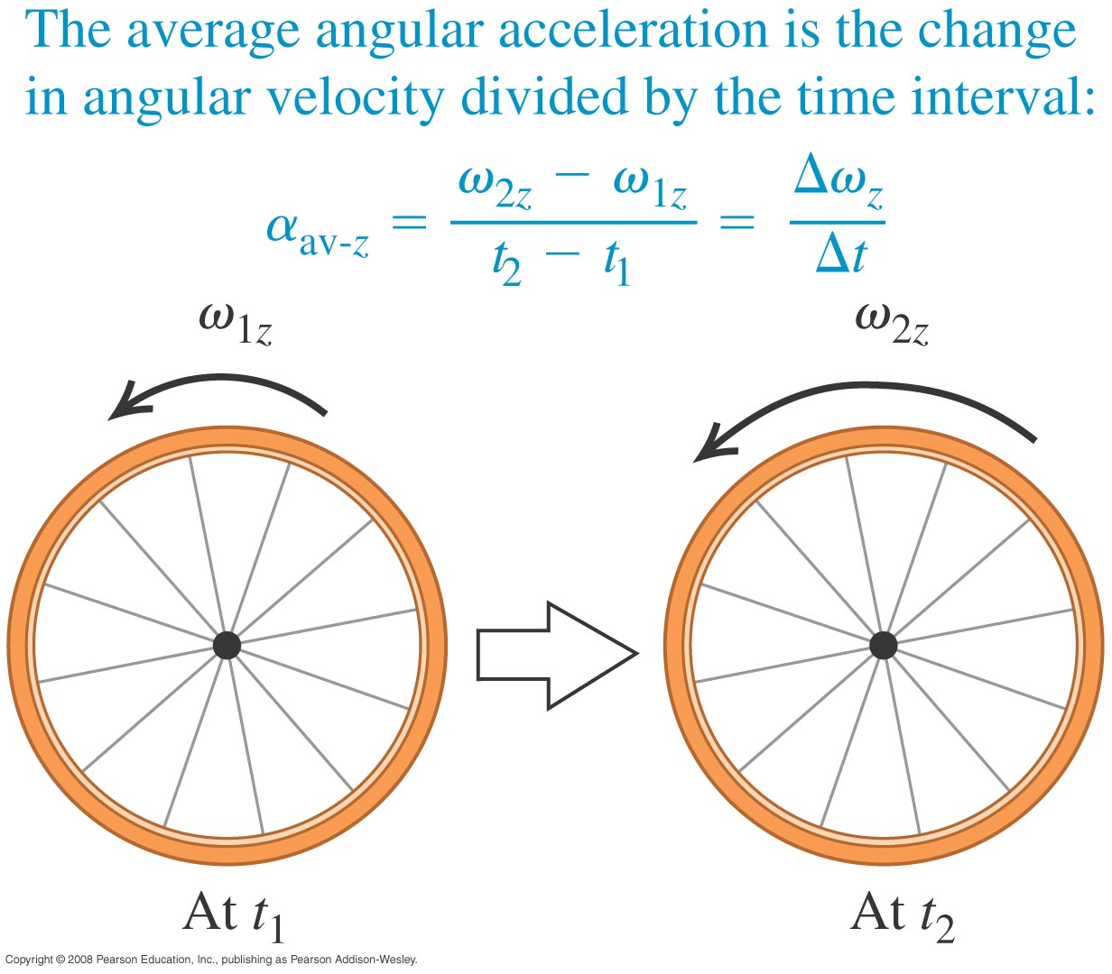
Angular acceleration
The average angular acceleration is α_{av-z} = Δω_{z}/Δt.
The instantaneous angular acceleration is α_{z} = dω_{z}/dt = d²θ/dt².

Slide 8
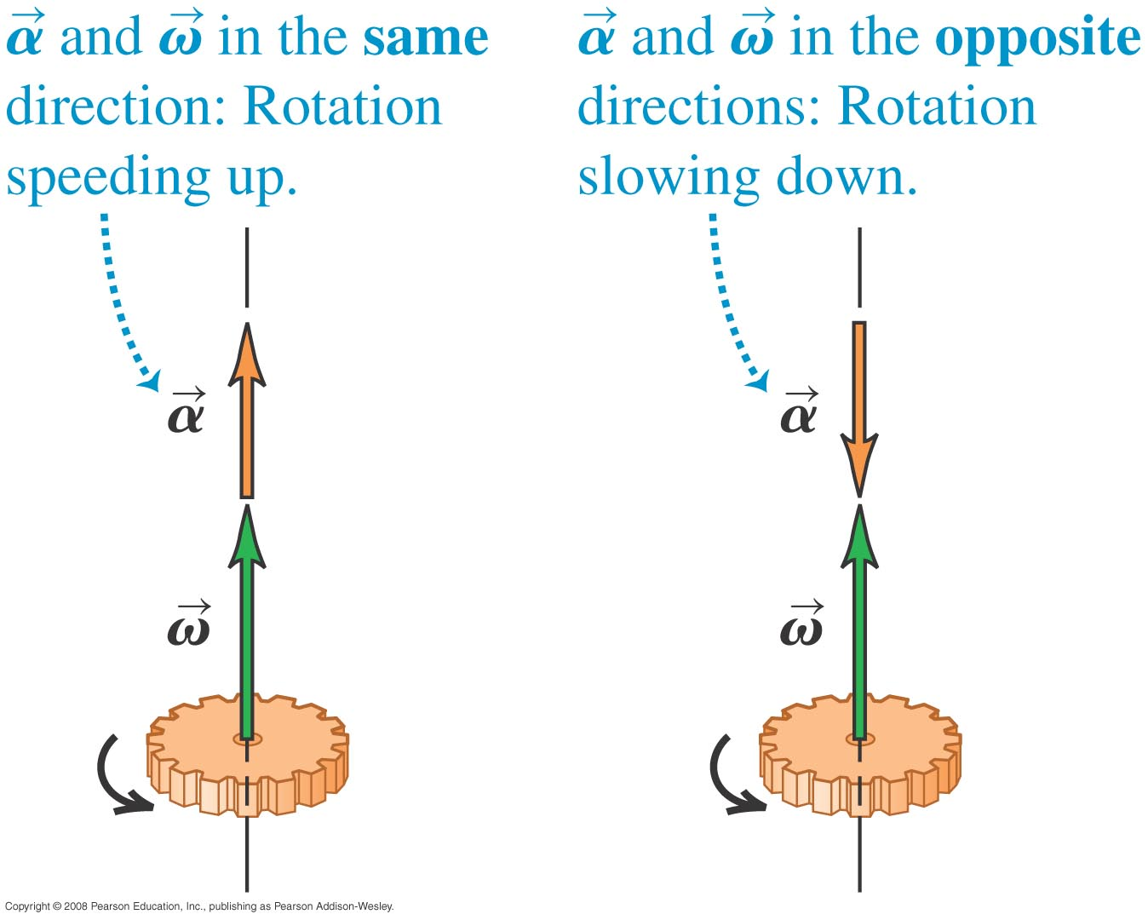
Angular acceleration as a vector
For a fixed rotation axis, the angular acceleration and angular velocity vectors both lie along that axis.

Slide 9
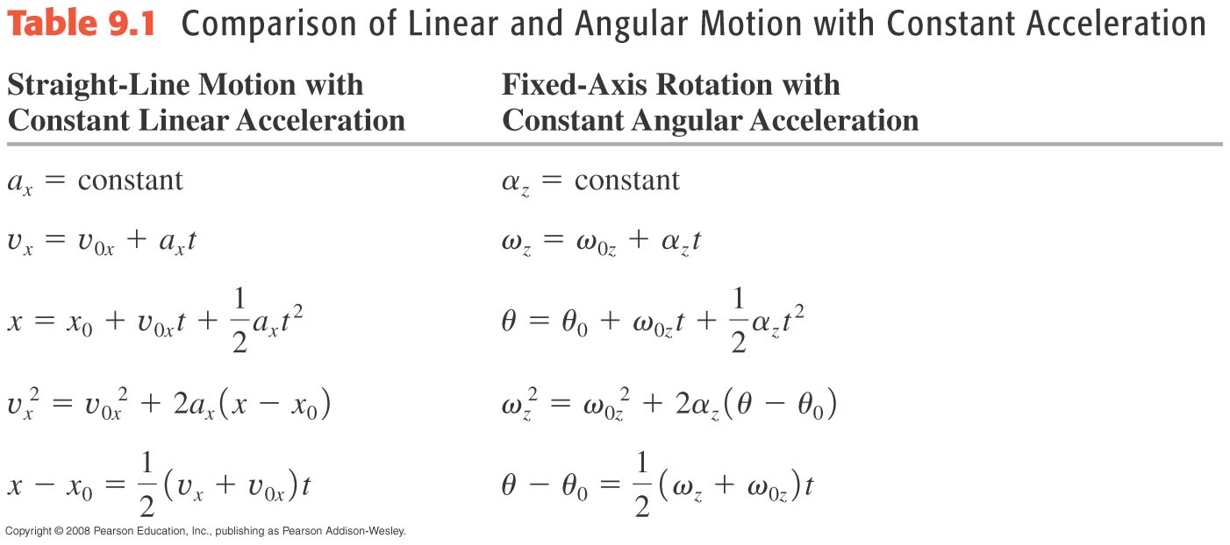
Rotation with constant angular acceleration
The rotational formulas have the same form as the straight-line formulas, as shown in Table 9.1 below.

Slide 10
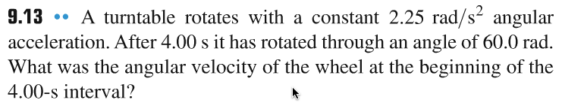
Problem #1

Slide 11
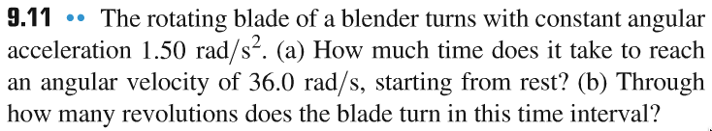
Problem #2

Slide 12
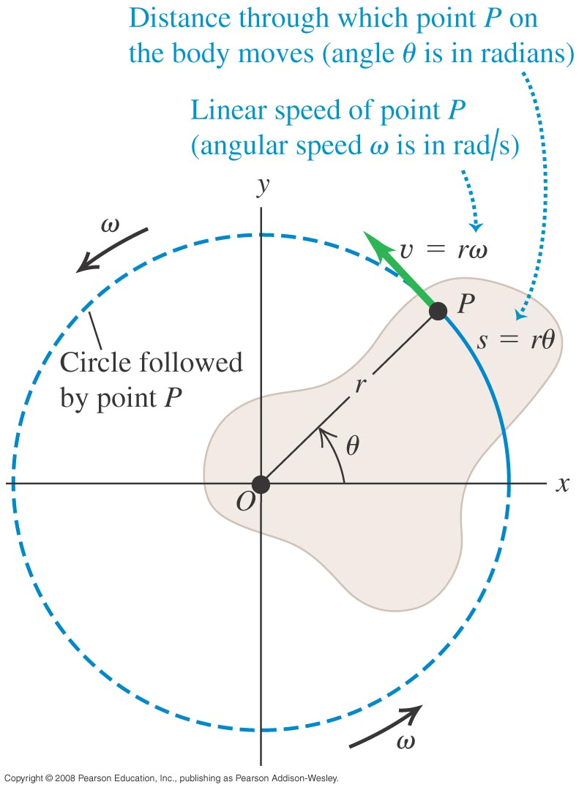
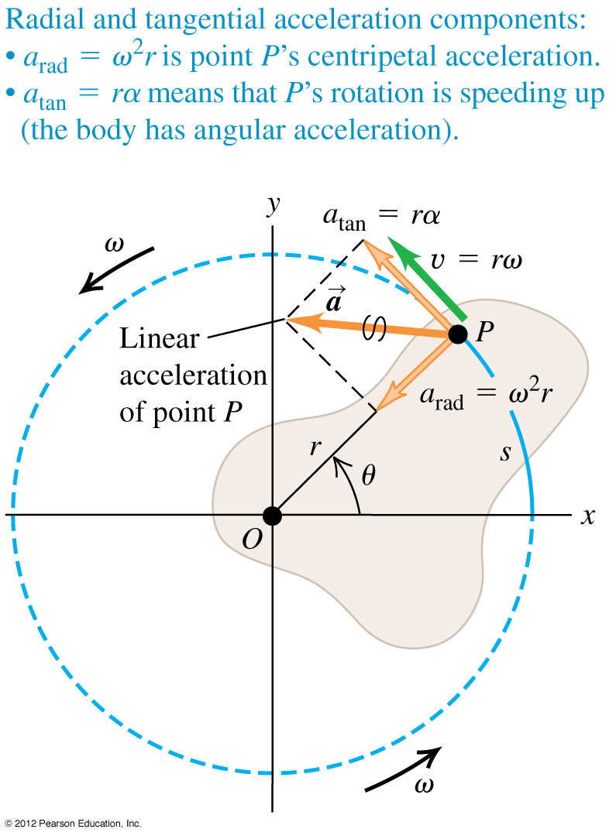
Relating linear and angular kinematics
For a point a distance r from the axis of rotation:
  its linear speed is v = rω
  its tangential acceleration is a_{tan} = rα
  its centripetal (radial) acceleration is a_{rad} = v²/r = rω²

Slide 13
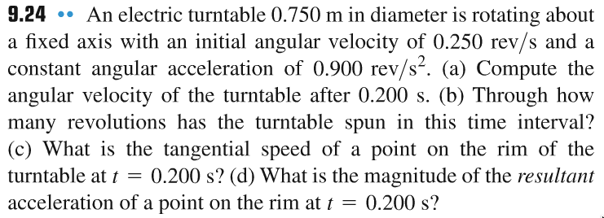
Problem #3

Slide 14
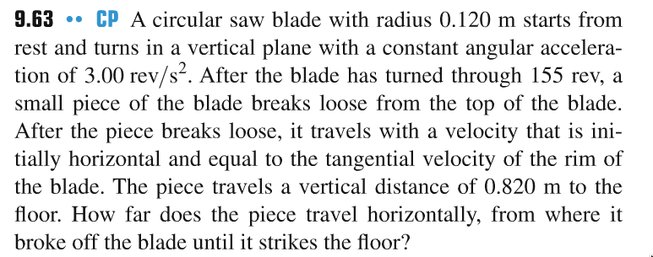
Problem #4

Slide 15
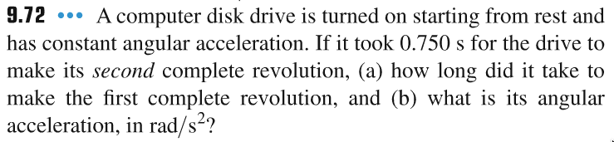
Problem #5

Slide 16
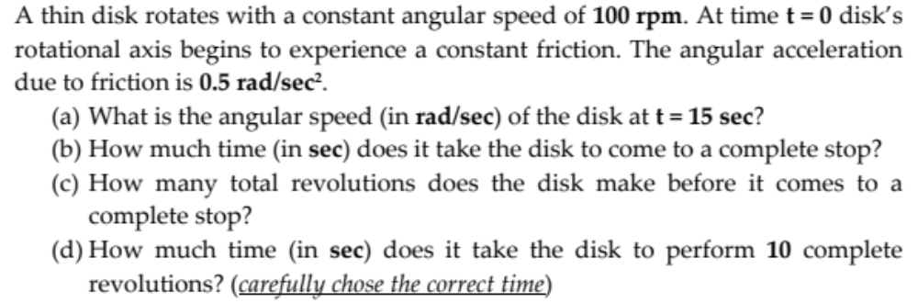
Problem #6

